Slide 1
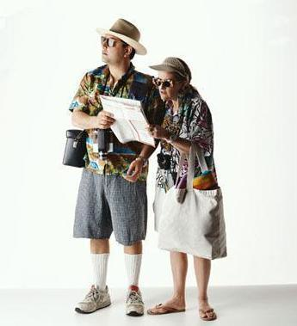
Tourism 12
Travelers: What does a Typical Traveler look like?

Slide 2
Understanding Travelers
Knowing travelers is key to successful tourism operations
A few things to know about them:
why they’re traveling
where they’re coming from
where they want to go
What they want to do
Details about their age, income, interests, etc.

Slide 3
Why do people travel?
3 main reasons:
Vacation and leisure
Business
Visit friends and relatives

Slide 4
Travel Market Segmentation
The 3 main reasons why people travel are actually made up of many ‘sub-categories’ or travelers
Sub-categories are called market segments
3 main types of market segmentation:
Geographic
Demographic
Psychographic
Identifying and using market segments helps to better understand travelers and thus to market to them more effectively

Slide 5
Travel Market Segmentation (contd)
Geographic:
Defining a target market according to where they live
Ex: warm destinations such as Mexico market to people in Canada during the winter, when Canadians might want a break from the cold

Slide 6
Demographic:
Defining a target market according to characteristics like age, gender, education, income, ethnic origin, etc.
Ex: cruises are often marketed to seniors more than any other age group

Slide 7
Psychographic:
Defining a target market according to their preferred activities, their interests, and their opinions
Ex: African safari vacations are marketed to people with a sense of adventure and enjoy the outdoors

Slide 8
Why People Don’t Travel (review)
Cost
Lack of time
Accessibility or distance
Age
Health
Fear
Travel tastes & experiences

Slide 9
Top 10 Sources of Inbound Tourism (2012)
US
United Kingdom
France
Germany
China
Australia
Japan
India
Mexico
South Korea
Hong Kong

Slide 10
Top 10 Destinations for Outbound Tourism (2012)
US
Mexico
Cuba
UK
Dominican Republic
France
Italy
Germany
Mainland China
Spain
Jamaica

Slide 11
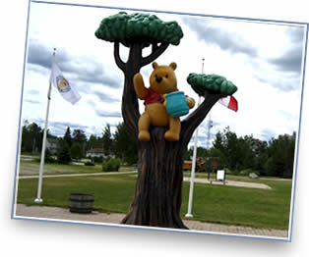
What do you think are some of Canada’s most popular tourist destinations?
Notes:
White River Ontario

Slide 12
Homework
Interview 3 people and ask them where they last travelled to (outside the lower mainland). Ask them WHY they went (what was their motivation)? What might’ve been barriers for them if they hadn’t gone?
Choose a province or territory and find 10 random facts about it. What is one of their big tourist destinations? What market segmentation would enjoy this the most? Give details from each category (geographic/psychographic/demographic)

